Slide 1
Git Workflow
I4SWT

Slide 2

Centralized VCSs (CVSs) – e.g. Subversion
Central repository stores all versions of all files. Clients (e.g. developers) update from/ commit to the repository
Pros:
Version control
Cons:
Requires access to the VC
Vulnerable to errors on central server

Slide 3
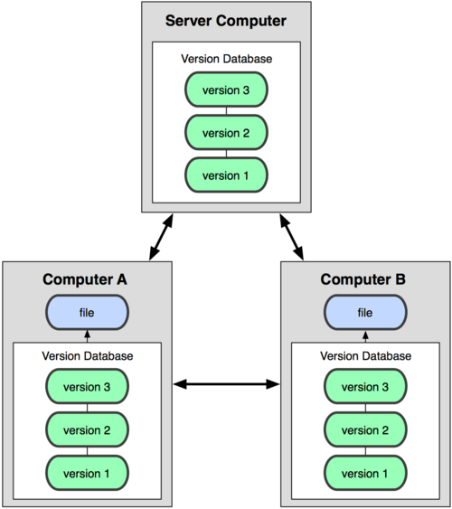
Distributed VCSs (CVSs) – e.g. Git
Clients hold full “mirror” (clone) of repository, not just latest & greatest
Pros:
Version control
Works offline
Server can be restored from any working copy
Cons:
Two-step sharing is a bit strange at first

Slide 4
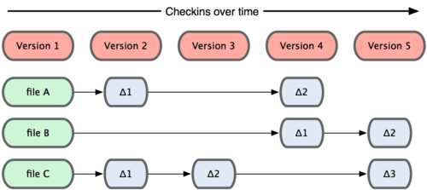
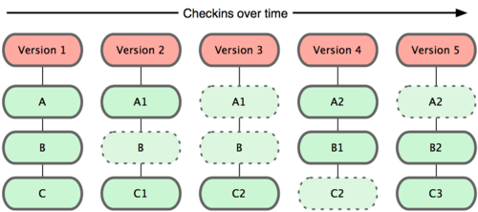
Snapshots, not differences
Differences
Recreate files from reverse deltas (not as pictured)
Can take ages to restore older versions
Snapshots
Mini-filesystems
All versions instantly available

Slide 5

Local file states and operations
Cloned from somewhere or
created on your local machine
Note:
VS2017 ”Commit” and
TortoiseGit ”commit -> master”
combine stage and commit steps!

Slide 6
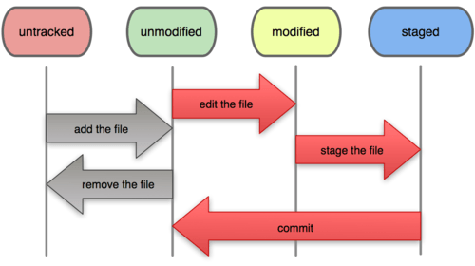
Recording changes to the repo
Tracked
These two steps combined in most git GUIs

Slide 7
Working with remotes
Clone
Add
Local repo
Remote
repo
Test!
Pull
Test!
Commit
Push
Local repo
Local repo

Slide 8
Pull – push work flow
CODE
Write TESTs and run them
CORRECT code
COMMIT when all tests are passed
PULL! From your common remote repository
Solve any MERGE conflicts
TEST! And correct until all tests are passed
COMMIT merges and changes
Now you can PUSH!
If somebody pushed since last pull – repeat from PULL!

Slide 9
Setting up remotes
Code and Test
Local repo
Create repo
Add
Commit
Remote
repo
Create or find remote repo
Push

Slide 10
Gitting Git, gitting started
Download and install Git interface and client
TortoiseGit
https://tortoisegit.org/download/
AND
Git for Windows - Git Bash shell for “nitty gritty” stuff
https://git-for-windows.github.io/
Remember to add Git Credential Manager
AND
Install GitHub Extension for Visual Studio

Slide 11
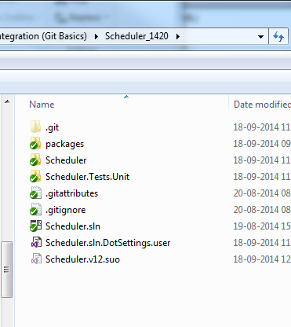
Local file structure

Slide 12
How to access a global repository
Clone repos, e.g from GitHub
Read-only (HTTP) (no password needed):
http://github.com/<githubuser>/<repository>
Read/write (HTTPS) (password required):
https://github.com/<githubuser>/<repository>
Other protocols are also available
Create a GitHub user to use for your team
Create your own teamrepositories on GitHub to use for each solution/exercise/hand-in

Slide 13

Stuff not to put in your repository
Do not check in any
*.ncb
*.suo
*.ilk
*.pdb
*.user
*.obj
Do not check in the build directories
Debug, Release (for traditional projects)
obj, bin (for .Net projects)
(Etc.)
Do not check in plug-in packages – they can be reinstalled
Git can use a .gitignore if you put it in your project
Visual Studio can generate one for you, if you follow one of the methods described in the following

Slide 14
Visual Studio focus points
Let VS create the local repository
Make sure the .gitignore file exists and is suitable for VS solutions
Let VS push or publish to a remote repository

Slide 15
Other methods
Move a VS solution to a local (cloned) repo
Create a VS solution in an already created/cloned local repo
Open a VS solution already part of a repo

Slide 16
Other work modes
Almost everything can be done by TortoiseGit
Everything can be done from the command line, using git

Slide 17
Git resources are abundant
Pro Git book ( http://git-scm.com/book )is really good - PDF, online
http://www.gitguys.com
http://gitready.com

Slide 18
Topics not covered
Handling merge conflicts
Branching
Covered later in the course

